Slide 1

Patient Portal
TheSquad - Joshua Mackey, Joshua Miller, Minseon Joo

Slide 2




How the Patient portal works
DOCTORS OFFICES
PATIENTS
MUNICIPALITIES
Receive patient form electronically
Send patients prescription/copy of X-rays/patients data to portal
Patient data storage
Able to send patient form to doctors office
Access to doctors who accepts patient’s insurance
Patient’s medical history analysis
Patients data analysis
Able to suggest helpful diet/treatment/service to patients via portal

Slide 3
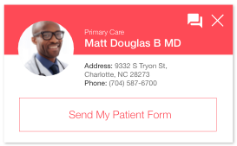
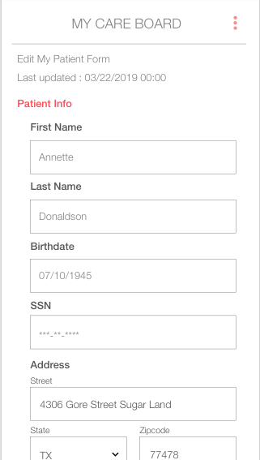
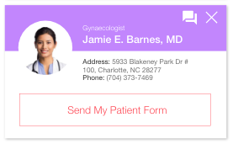
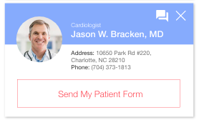
Fill out patient form once for all

Slide 4
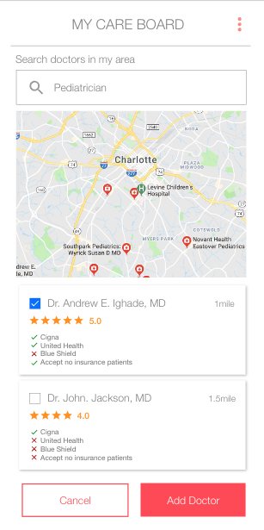
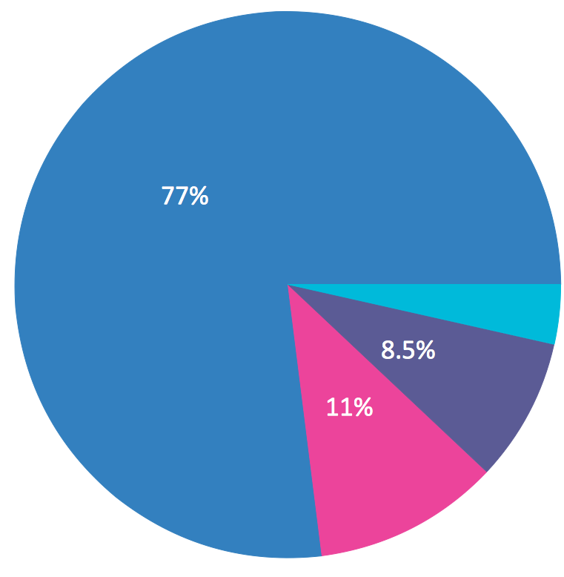
Analyze patients’ medical history
77% of patient’s doctors office visit was due to sore throat and cold symptoms
Push Notification
Take vitamin C, use humidifier to prevent cold.
- Mecklenburg County

Slide 5
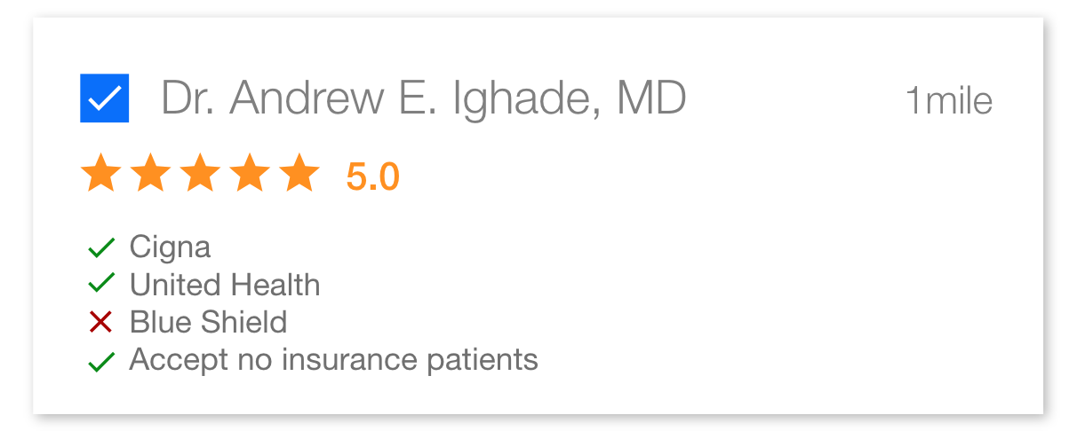
Find your doctor regardless of insurance
Patients fill out review with answers to specific questions
i.e) Which insurance did your doctor accept?
A.Cigna B.United Health C. Blue Shield
D. Accepts patients with no insurance

